Slide 1
HISTORY
On April 7, 1818, Henry Sands Brooks opened the doors of his clothing store in downtown New York City. Guiding this new venture was a forward-thinking mission statement: “to make and deal only in merchandise of the best quality.” In 1850, Henry Sands Brooks’ children renamed the company, which was already emerging as a leader in ready-made clothing, Brooks Brothers.
By the turn of the twentieth century, much of contemporary American dressing had roots in the styles first introduced by the company — such as the famous Number One Sack Suit. The 1930s and 1940s saw an expansion of offerings, including the U.S. introduction of argyle, madras and seersucker.
During the postwar period, female customers began wearing the boys’ pink oxford, a trend soon featured on the cover of Life magazine. When Brooks Brothers partnered with Vogue to make a pink shirt just for women, they created an overnight fashion sensation. In 1949, Brooks Brothers devoted a small corner of its store to women’s merchandise. And in 1976 the company launched its first full-scale women’s department.
With almost 200 years of heritage, Brooks Brothers is firmly established as an iconic American brand with a global presence.

Slide 2
HISTORY
ESTABLISHED IN 1818, MAKING US THE OLDEST AMERICAN RETAILER.
FIRST TO OFFER READY-TO WEAR SUITS (1845).
THE BUTTON DOWN POLO COLLAR SHIRT (1896).
OTHER INNOVATIONS INCLUDE: SEERSUCKER, THE REPP TIE, MADRAS, ARGYLE SOCKS AND THE ALL COTTON NON IRON SHIRT.
BROOKS BROTHERS IS AN AMERICAN ICON.

Slide 3
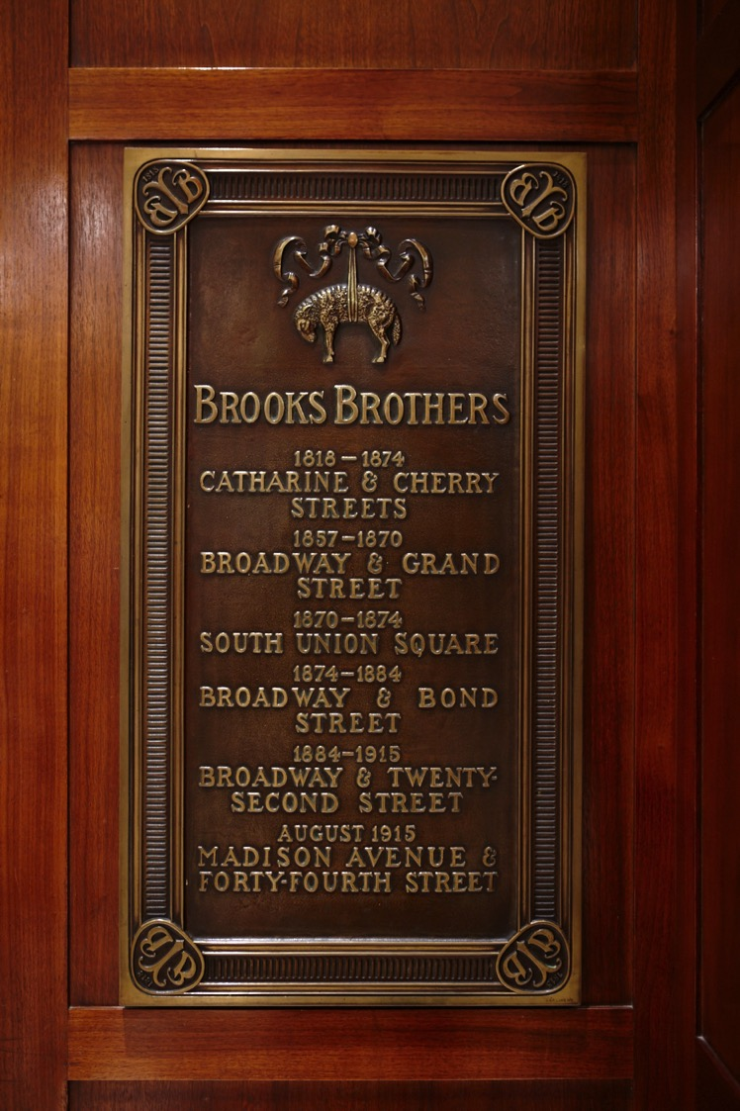
Brooks Brothers in History
ABRAHAM LINCOLN wore a magnificent coat crafted for him that on the lining had an elaborate eagle with the inscription:
“One Country , One Destiny”

Slide 4
QUESTIONS THAT DETERMINE YOUR PROFESSIONAL WARDROBE
WHAT BUSINESS FIELD AM I ENTERING?
WHAT IS THE COMPANY’S DRESS CODE?
WHAT ARE MY DUTIES AND MY CURRENT POSITION?
WITH WHOM WILL I BE INTERACTING?
WHAT MESSAGES DO I NEED TO CONVEY?
WHAT DO I HAVE IN MY WARDROBE?
HOW LARGE IS MY CLOTHING BUDGET?

Slide 5
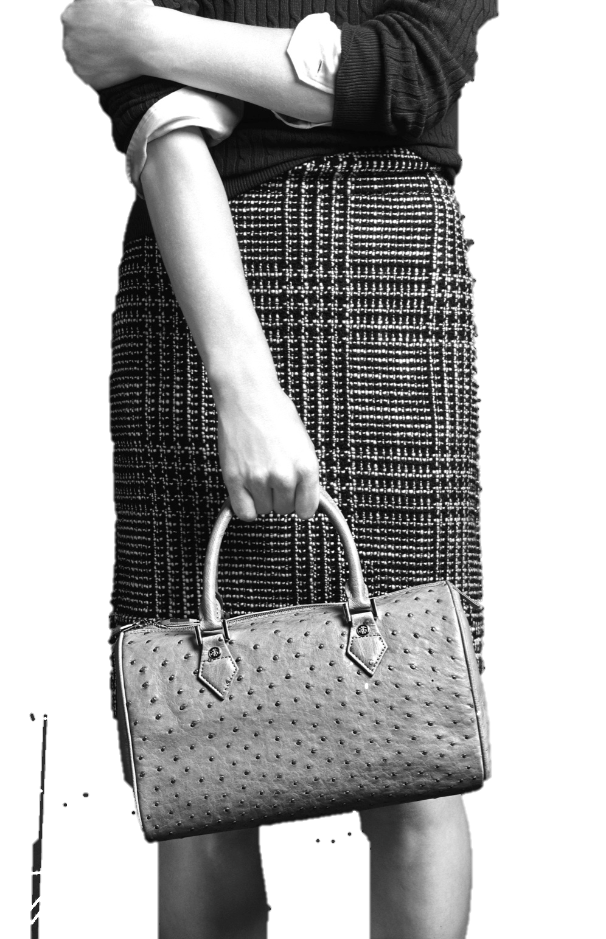
THE STYLE MANUAL FOR HER

Slide 6
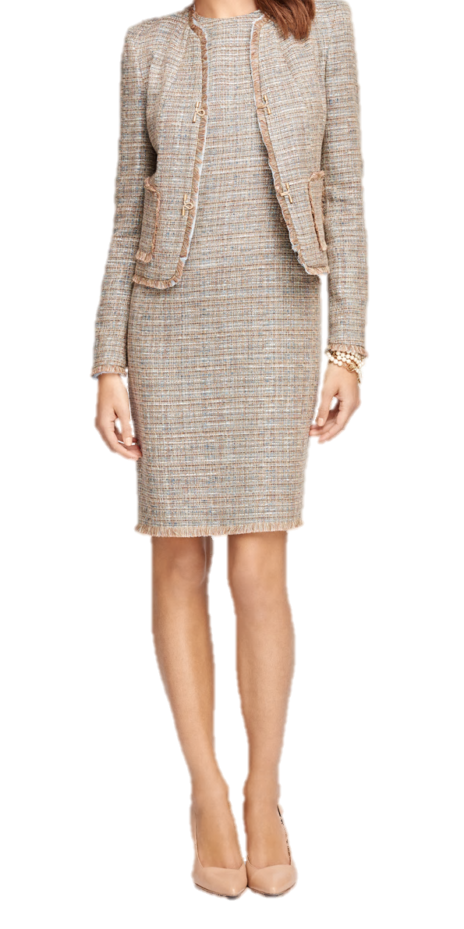
Agenda
QUESTIONS
INTERVIEWING
CLASSIC BUSINESS SUITING
CHOOSING THE RIGHT SHIRT
CASUAL BUSINESS ATTIRE
CHOOSING THE RIGHT TIE
FOOTWEAR & ACCESSORIES
WEAR AND CARE
WRAP-UP

Slide 7
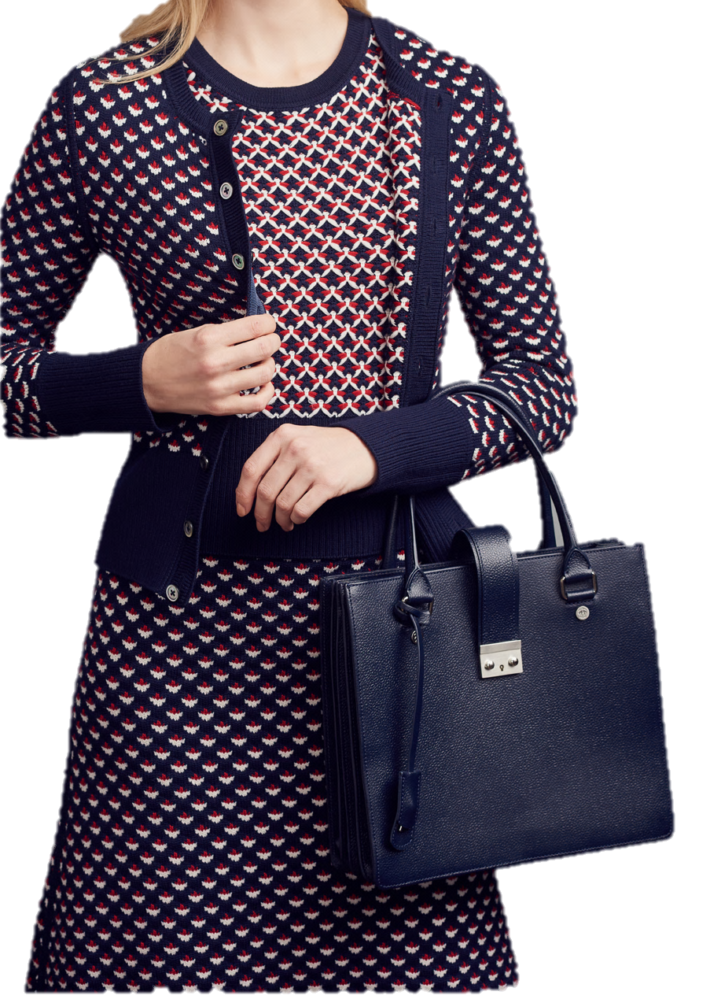
Interviewing
INTERNSHIPS OR JOB INTERVIEWS
KNOW YOUR AUDIENCE
WHAT YOU ARE WEARING SHOULD NOT OVERSHADOW YOUR PERSONALITY AND ABILITIES
FIRST IMPRESSION

Slide 8
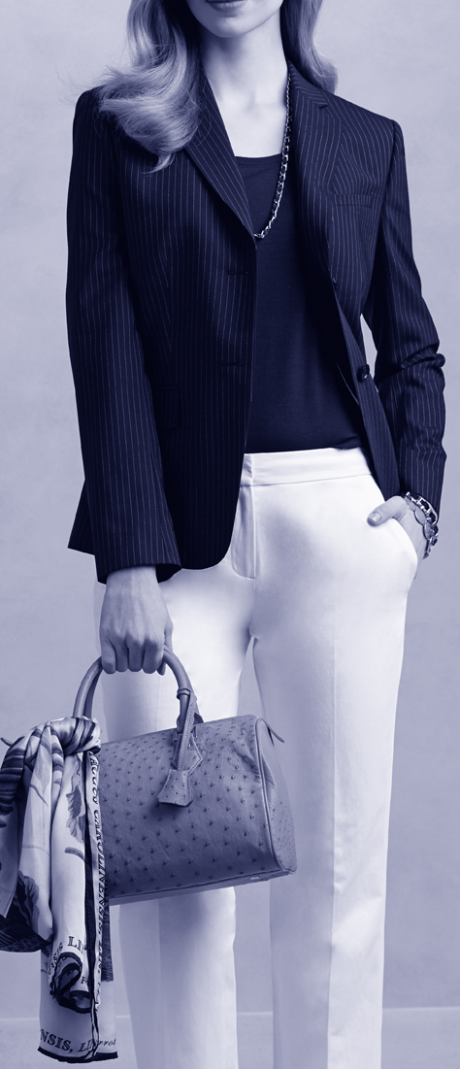
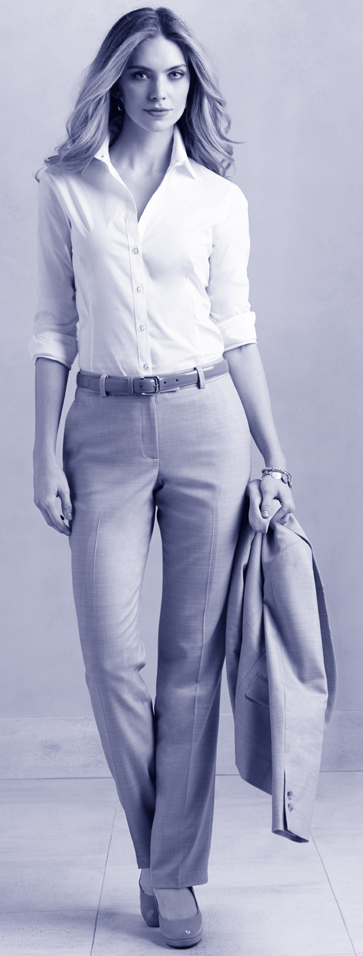
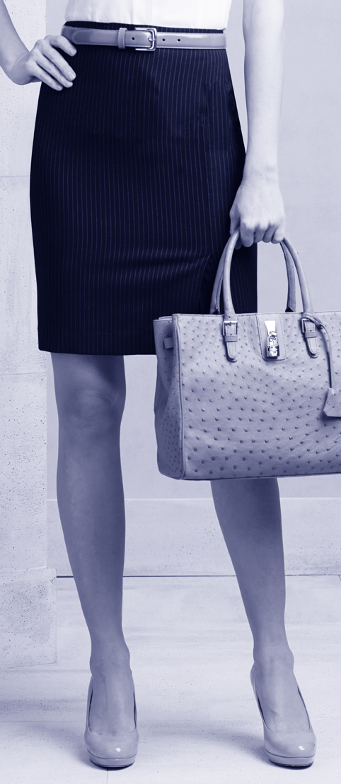
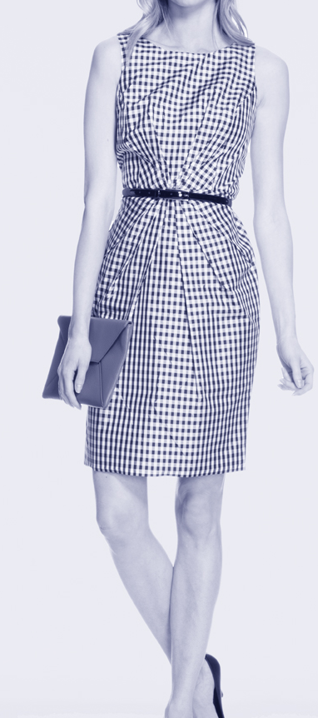
HOW TO BUILD A WARDROBE
By mixing and matching these timeless pieces, you can create many different looks and maximize your wardrobe.
^{JACKET}
A black, gray or navy jacket is one of the most essential items in your wardrobe. Wear with a shirt, shell or sweater for day, or a lace camisole for evening. With the addition of a jacket, you can turn your day dress into a power suit.
Tip: Dry-clean your garment sparingly — no more than once or twice a season. Too much dry cleaning will break down and discolor the fabric.
^{PANTS}
Choose the rise that is most comfortable, and concentrate on flattering silhouettes. The trendier the pants — such as ultra wide or super thin — the more dated they become. Consider mid-rise pants with a flat waistband (no belt loops) and a tailored fit.
Tip: Invest in more than one pair, and have them hemmed for higher or lower heels.
^{SKIRT}
A skirt that hits just above or just below the knee moves from day to evening with authority. Pencil skirts complement most body types, while an A-line skirt accentuates a small waist and minimizes hips, and a pleated skirt adds a sophisticated feminine touch.
Tip: When debating your work skirt length, sit down in front of the dressing room mirror, cross your legs and check to ensure you are not overly exposed.
^{DAY DRESS}
Paired with a jacket or cardigan, a dress is an easy, all-in-one option. Sheath and A-Line dresses are versatile choices that offer a polished suiting look when paired with a jacket. The belted trench and shirt dress lean more toward a casual office look.
Tip: Try mixing patterns and textures when choosing a dress and pairing with a cardigan or jacket, but never stray from a shared color palette.

Slide 9
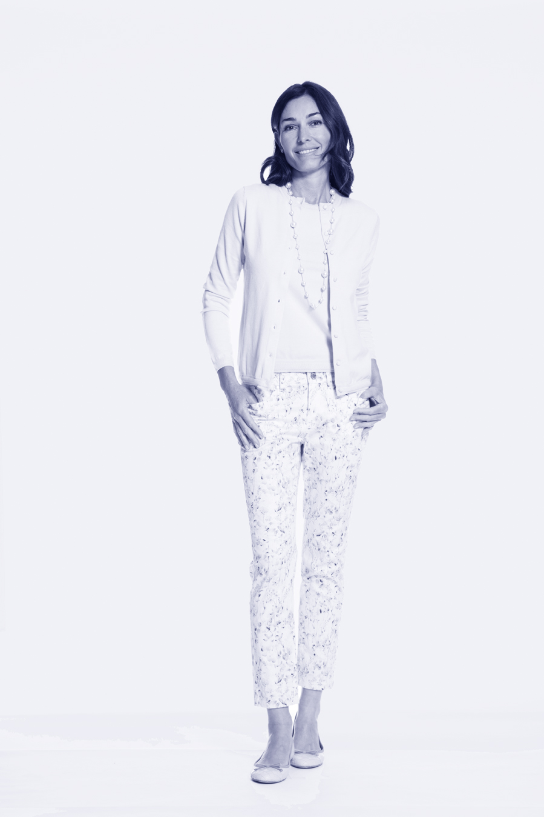
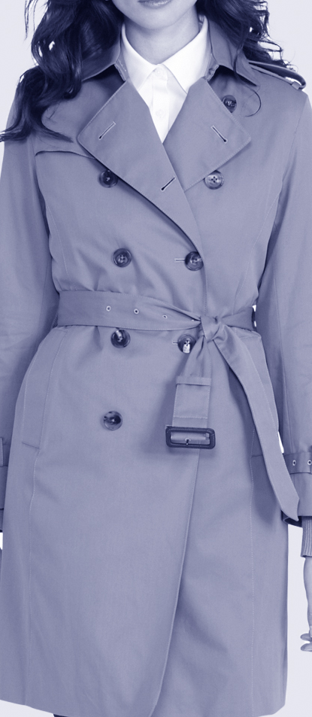
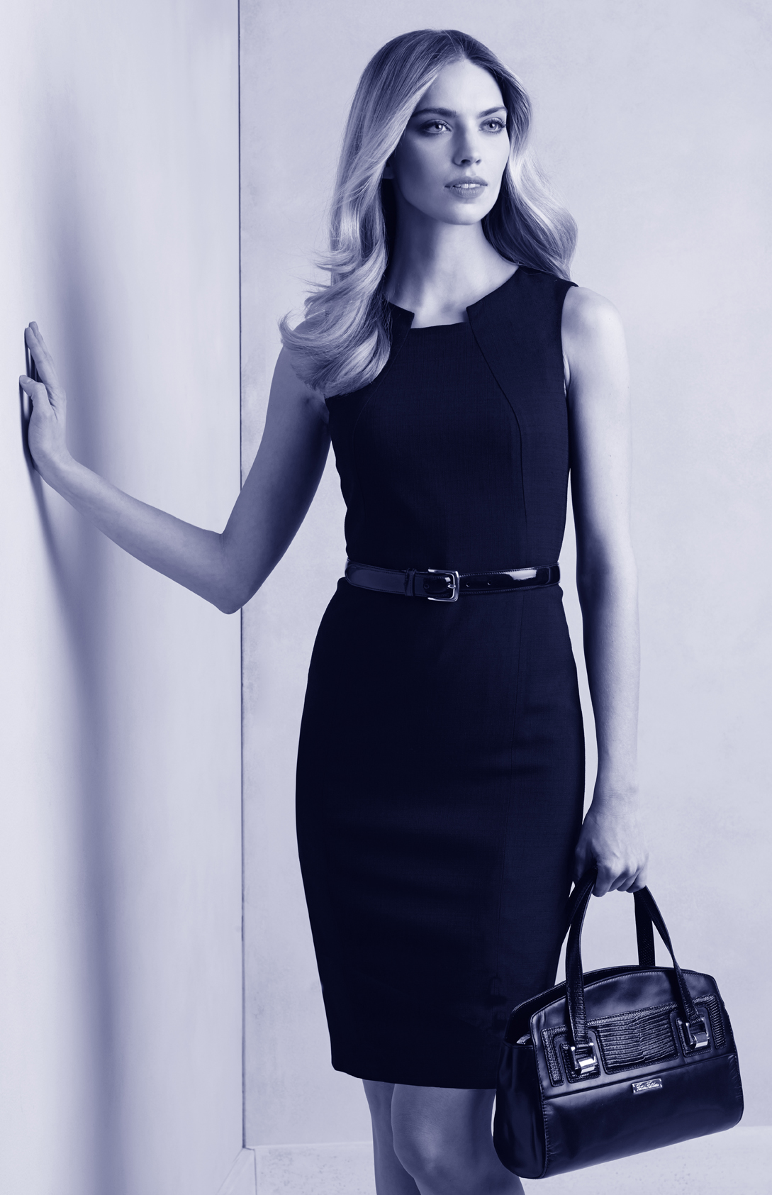
HOW TO BUILD A WARDROBE
By mixing and matching these timeless pieces, you can create many different looks and maximize your wardrobe.
^{DRESS SHIRT}
No other item in your closet has the casual versatility or elegant appeal of the dress shirt. An open neckline creates a flattering and neck-elongating V-shape that can be accessorized with jewelry or a silk scarf. Buttoned up and anchored with a pin or worn with pearls, the look becomes chic, especially when paired with a jacket in a contrasting color.
Tip: Wear a nude bra with a white or light-colored shirt to avoid visible bra lines.
^{TWINSET}
Worn together this knitted pairing is a classic, yet when these two pieces are separated, their versatility is apparent. Twinsets are a way to bring in seasonal colors and allow you to effortlessly go from cool to warm. Wear the shell over a blouse for a layered look; both shell and cardigan work under a jacket.
Tip: For an evening look, trade the shell for a silk camisole worn under the cardigan.
^{TRENCH COAT}
Iconic, indestructible and figure-flattering when snugly wrapped and belted in front, a quality trench is constructed to fit over a blazer, making it perfect for daily commutes or transcontinental flights. Trench coats are generally available in black or khaki, and the necklines are perfect for pairing with a wool or silk scarf to add a stylish accent.
Tip: Alternatively, do not button and belt the trench — just wrap and tie.
^{LITTLE BLACK DRESS}
A versatile wonder, the LBD can be layered many ways — with a crisp or silky blouse underneath, with a sharp jacket or cardigan worn over top, or on its own with a contrasting scarf.
Tip: Try a brooch at the neckline for day or at the waist for evening, pulled together with an elegant wrap for day-to-night perfection.

Slide 10
Our Stylist’s Tips
^{IT’S A FIT:}
Make sure your clothing fits at the widest part of your body — for most women, that means the hip and waist area as well as the shoulder and bust area. Check that the shoulder seam lies at the outer edge of your shoulder line. Choose the size that fits best and allow our tailors to work their magic.
^{THE EDIT:}
Make sure you remove at least one item for every new look you add to your closet. Buying fewer yet higher-quality items curates your closet, and you may be surprised at how well the clothes you truly love work together — even when you haven’t planned it that way.
^{GET STEAMED:}
Unless you experience an unfortunate spill, use a clothes brush to restore fabric’s nap, and steam or spot clean rather than dry-clean to revitalize the fabric. This will keep your wardrobe looking fresh and vibrant for years.
^{FIND A TAILOR:}
A trusted tailor will fine-tune most garments as a finishing touch to create a truly personalized fit. Ask your tailor’s opinion, and don’t be afraid to purchase a bigger size and tailor down.

Slide 11
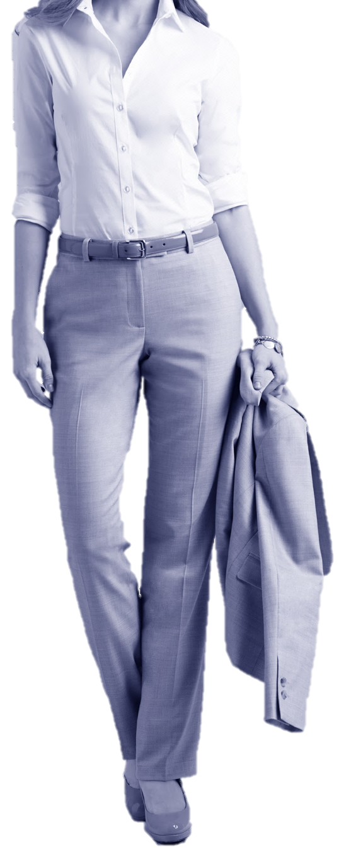
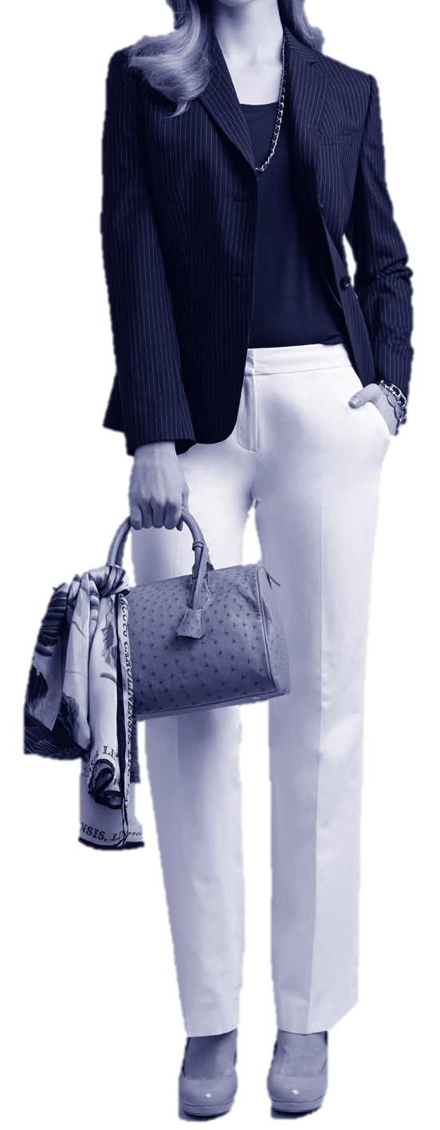
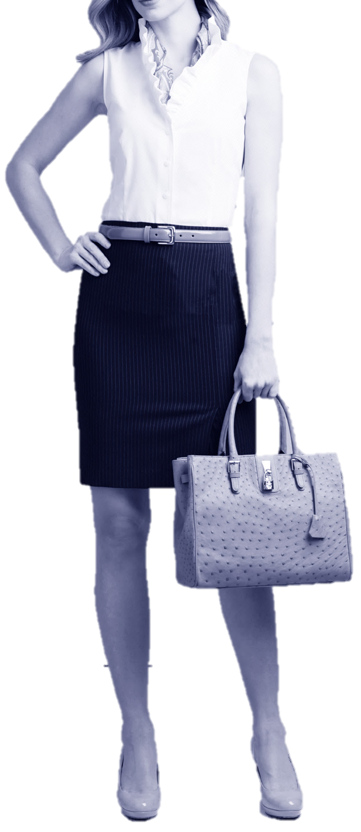
Classic Suiting

Slide 12
Classic Suiting
BUILDING YOUR WARDROBE

Slide 13

Classic Suiting
BUILDING YOUR WARDROBE

Slide 14
Classic Suiting
BUILDING YOUR WARDROBE

Slide 15
Classic Suiting
BUILDING YOUR WARDROBE

Slide 16
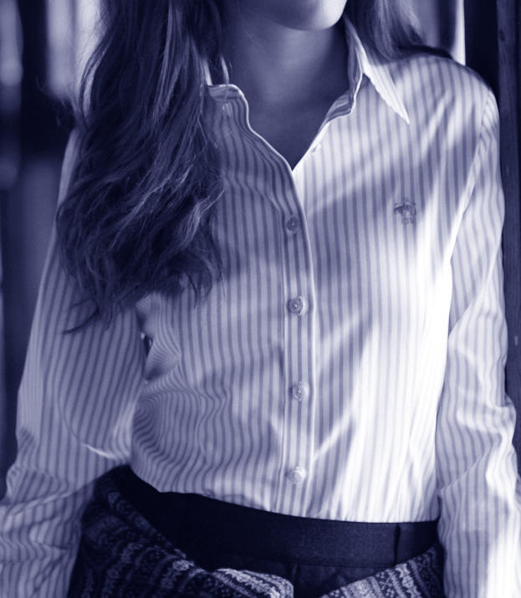
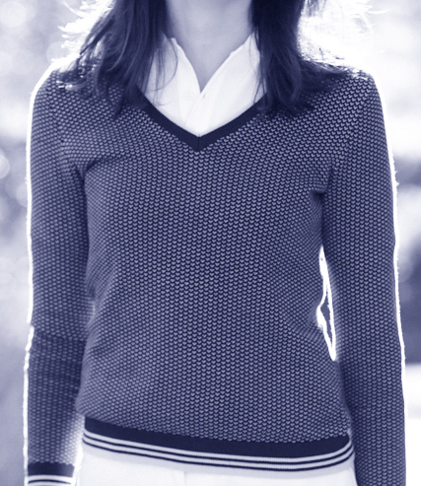
THE MAIN COMPONENTS
Your work wear wardrobe should consist of a few well-tailored, high-quality basics and a selection of your favorite accessories.
Build a core collection of suiting essentials and separates — pants, jackets, skirts and a few dresses. Choose these staples
each season, giving thought to fabric, silhouette and pattern. Next, play with mixing and matching by weaving in fresh
pieces with colors and accents to achieve a look that is effortlessly chic, polished and professional.
^{FABRICS BY SEASON}
Opt for materials that are seasonally appropriate and comfortable.
Fall/Winter — Wool, wool blends and poly or microfiber blends offer ^{warmth and breathability.}
Spring/Summer — Linen, cotton and seersucker are lightweight and ^{cool during warmer months.}
Year-round — Silk and some lightweight blends are ideal year-round.
^{CHOOSING COLOR AND PATTERN}
For those professions in which head-to-toe suiting is required, a black suit always looks crisp, modern and stylish.
Other neutrals, such as dark gray and navy, are an alternative to black, while still looking clean
^{and classic.}
Pinstripes, plaid and novelty prints can lend fresh texture as well as a seasonal twist to any look.
^{THE CHECKLIST}
A well-edited wardrobe is key to professional success. These are the essentials you’ll need in your closet.
^{THE SUIT}
Fabric is the single most important consideration. Advances in technology have led to a diverse selection of modern fabrics that suit women’s figures and active lifestyles.
These blended materials are woven with a hint of stretch yarn to allow for greater ease of movement and a more contoured, natural fit.
The stretch component also minimizes wrinkling and enhances durability.
^{THE JACKET}
Polished, sharp and easy to mix and match, your jacket or blazer is the most versatile piece you’ll own.
Wear it as a classic suit with complementing pants, dress or skirt, or alternately over chinos or over a sleek sheathdress.

Slide 17
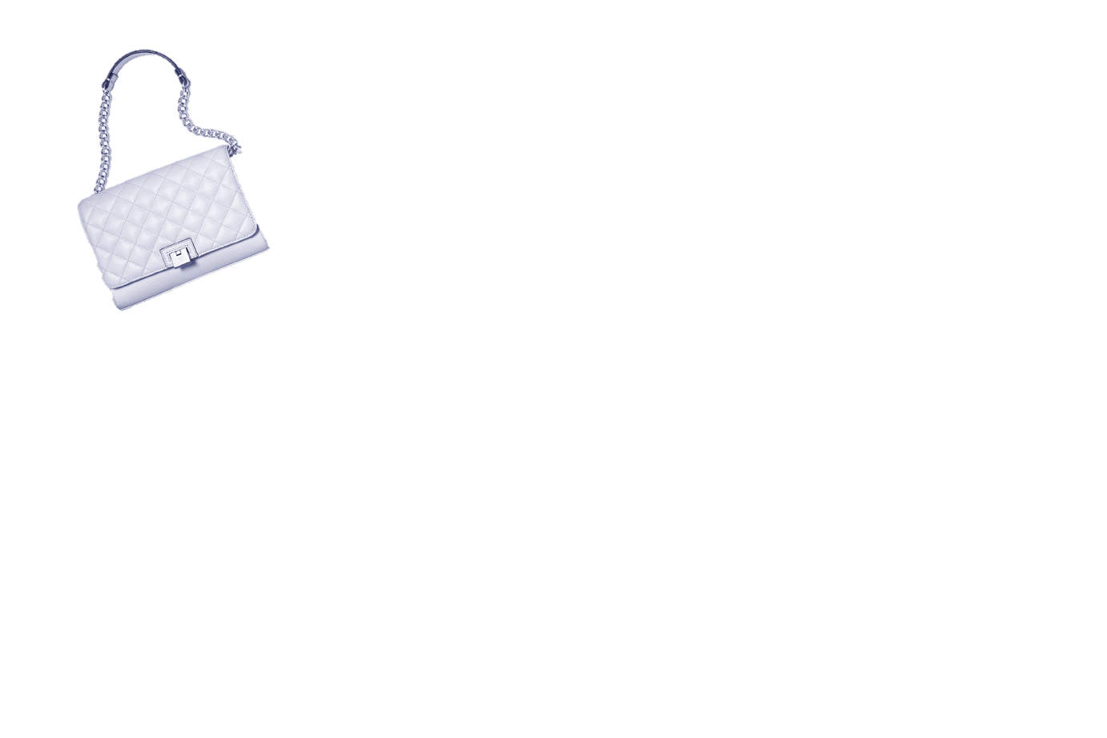

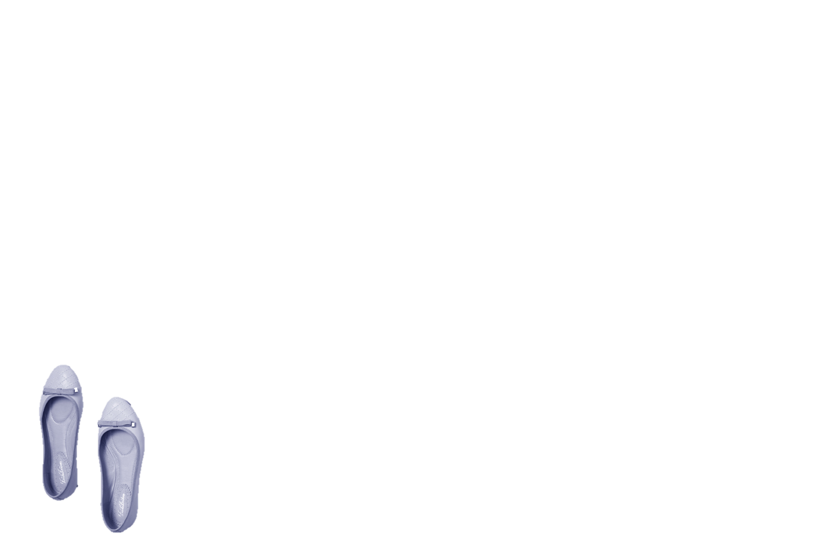

THE MAIN COMPONENTS
^{THE PANTS}
The fit at the waist and hip should be trim but never tight, with a small yet comfortable amount of give whether you’re seated or moving.
• Slimmer, pencil-leg pants should hit just slightly above the ankle.
• Wider-leg trousers should fall cleanly to the top of your shoe with little to no break. (A break is the fold created in the fabric when your pants leg hits your shoe.)
• Always bring the shoes you plan on wearing when you go for pants alterations. The height of the heel affects the hem.
^{THE SKIRT}
• Length is a matter of personal preference. The most flattering skirt length typically hits just above or just below the knee.
• A-Line and Pencil Skirts: Close-fitting, clean and always flattering and can be paired with virtually any shape or length of top.
• Box Pleat and Flare Skirts: These have more volume and pair nicely with waist-defining tops, tailored blouses or cardigans.
^{THE DAY DRESS}
• Sheath and A-Line Dress: Feminine suiting foundation pieces, they’re versatile classics.
• Trench Dress: A variation of the iconic coat is a great seasonal transition piece. (Try wearing it as a jacket over slim pants and a simple top.)
• Shirt Dress: A comfortable, slightly more casual option for office wear.
• Knit Dress: Typically more close-fitting; opt for designs that drape rather than cling.
^{THE DRESS SHIRT}
• A crisp white shirt is striking on its own or paired with a blazer.
• Innovative fabrics such as stretch cotton and other blends allow for a closer, more feminine fit while resisting wrinkling.
^{THE TWINSET}
• A wardrobe staple, twinset options include everything from knit shells to more structured, jacket-like cardigans.
• Fall/Winter — Our exclusive SaxXon™ wool, merino wool and cashmere sweaters are ideal.
• Spring/Summer — Opt for lighter knits and blends of cotton, silk and linen.
^{THE TRENCH}
• The cotton-twill trench coat has four-season appeal.
• A removable lining and horn buttons are classic details that provide style and versatility.
• A traditional trench is belted and typically features side pockets and shoulder epaulets.
^{ESSENTIAL ACCESSORIES} Accessories are the finishing details that personalize
your look and elevate your style.
Silk scarf • Cashmere wrap • Handbag • Clutch • Belt • Pumps • Ballet flats

Slide 18
The Little Black Dress
A longtime wardrobe staple, the little black dress (LBD) was first introduced by Coco Chanel in 1926. The dress was designed to fit all silhouettes, and the color slimmed the figure and stood up well to frequent wear.
^{STYLING TIPS}
• Think of the LBD as a blank slate. You can keep it simple and chic or use it as a backdrop for a gorgeous silk scarf or a piece of statement jewelry.
• Select a silhouette that’s classic and will get the most use over time.
• Use jewelry and other accents to take the look from office-ready to evening —
a beaded cardigan, patent leather heels or pearls can do the trick.

Slide 19
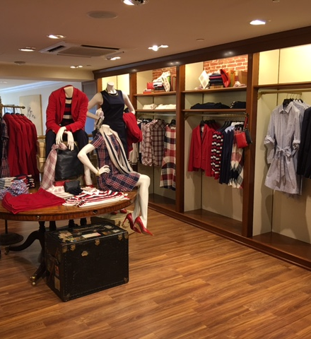
Red Fleece

Slide 20
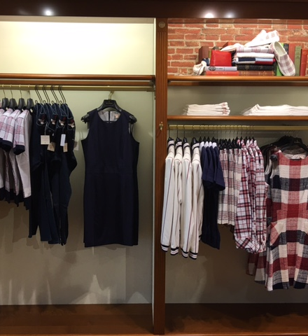
Red Fleece

Slide 21
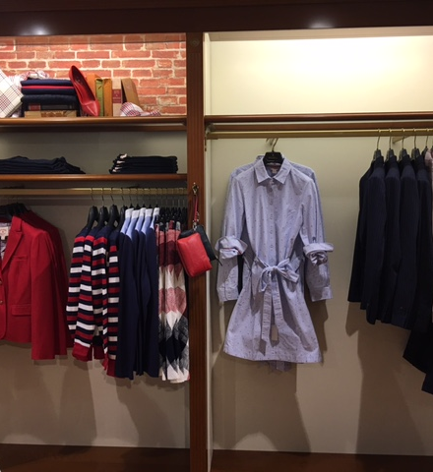
Red Fleece

Slide 22
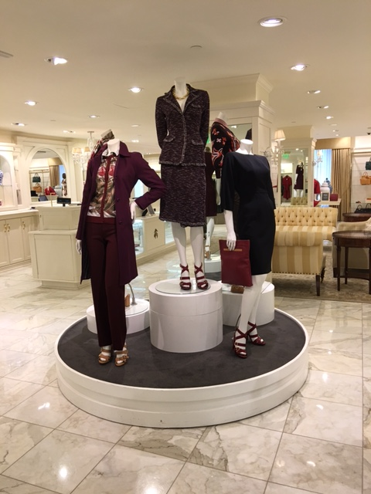
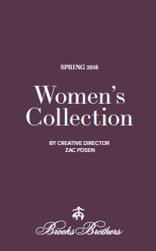

Slide 23
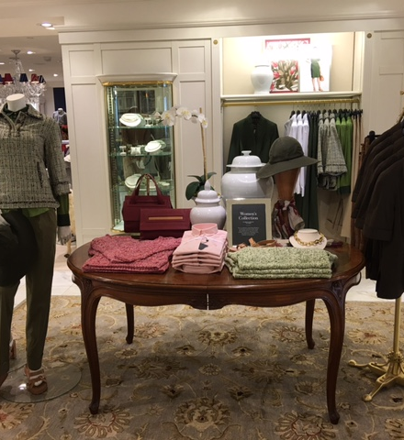

Slide 24
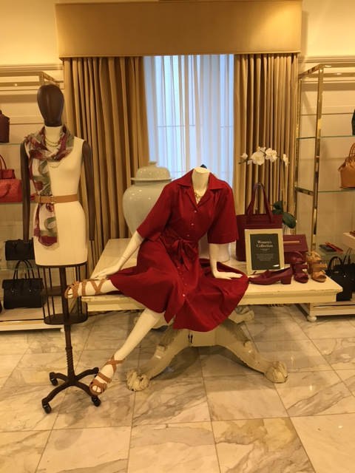

Slide 25
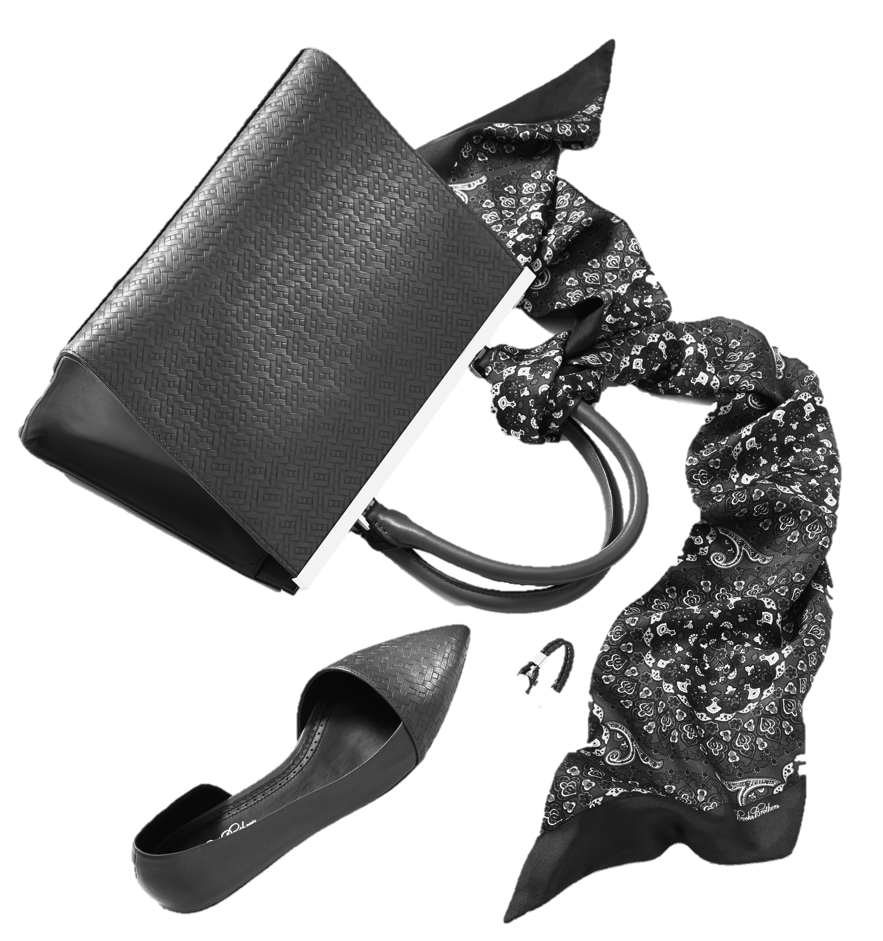
Wrap-Up

Slide 26
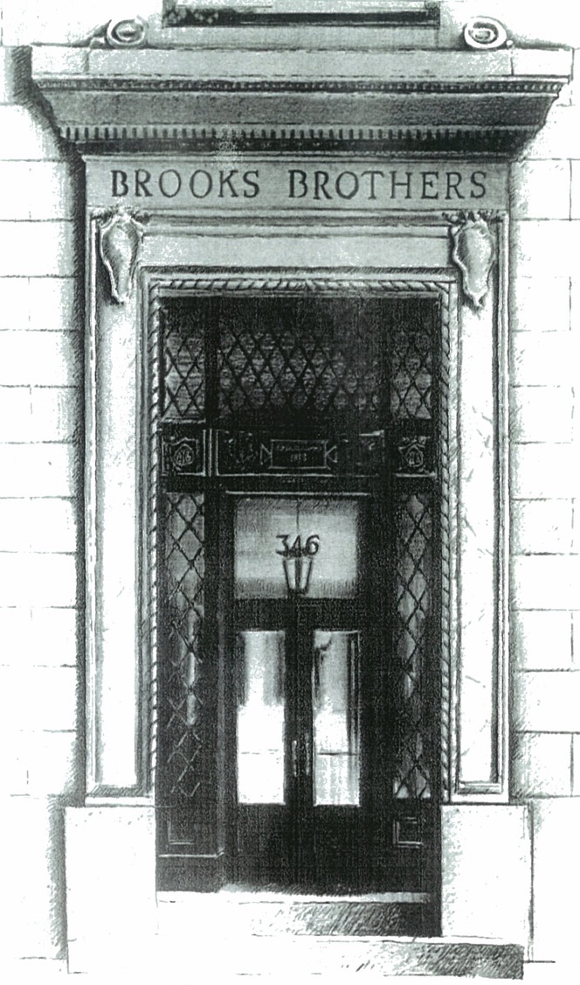
THE STYLE MANUAL FOR HIM

Slide 27
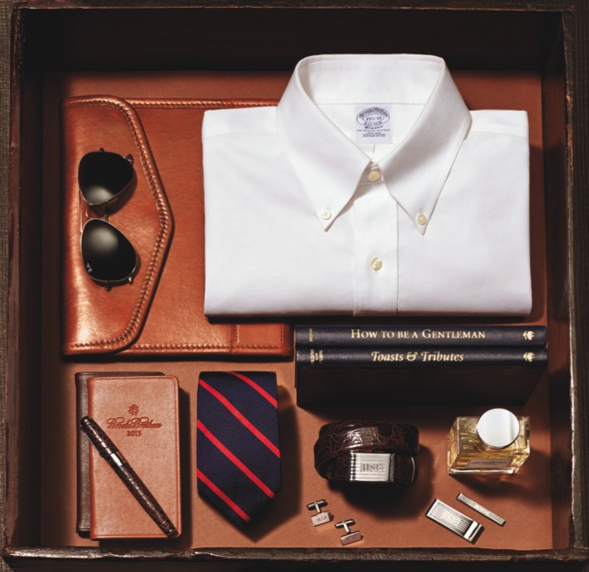
Agenda
QUESTIONS
INTERVIEWING
CLASSIC BUSINESS SUITING
CHOOSING THE RIGHT SHIRT
CASUAL BUSINESS ATTIRE
CHOOSING THE RIGHT TIE
FOOTWEAR & ACCESSORIES
WEAR AND CARE
WRAP-UP

Slide 28
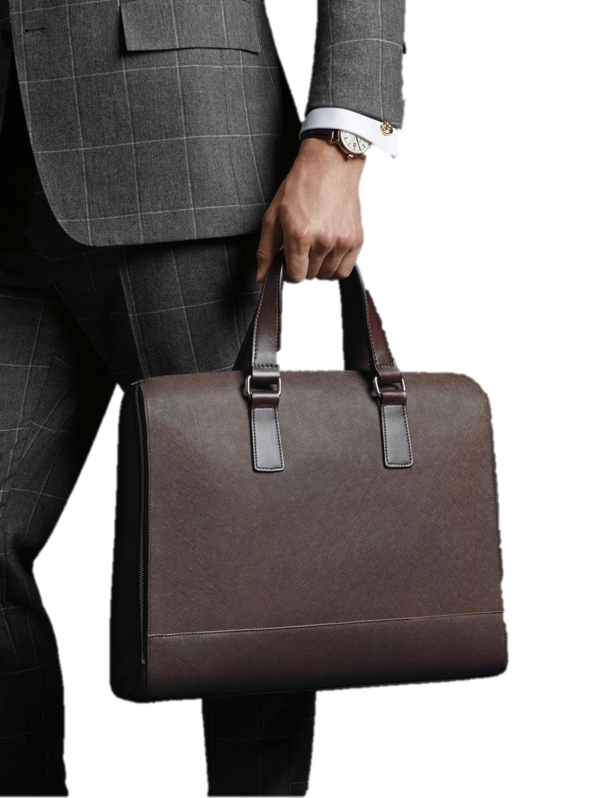
Interviewing
INTERNSHIPS OR JOB INTERVIEWS
KNOW YOUR AUDIENCE
WHAT YOU ARE WEARING SHOULD NOT OVERSHADOW YOUR PERSONALITY AND ABILITIES
FIRST IMPRESSION

Slide 29
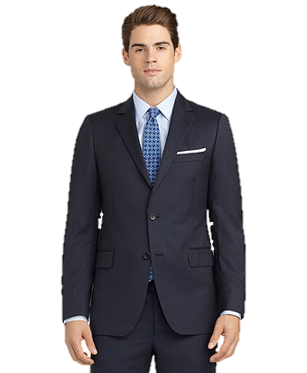
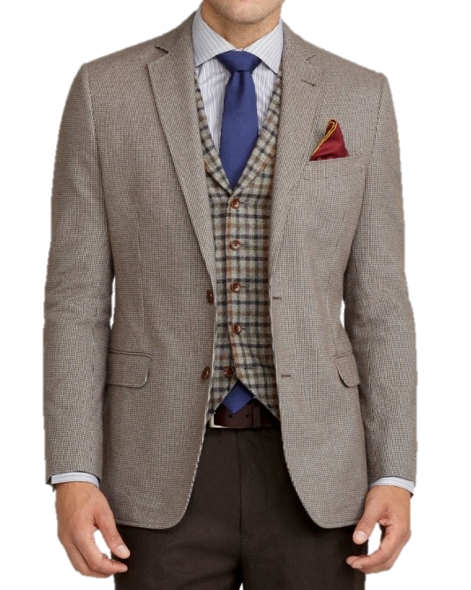
Classic Suiting Business Casual

Slide 30
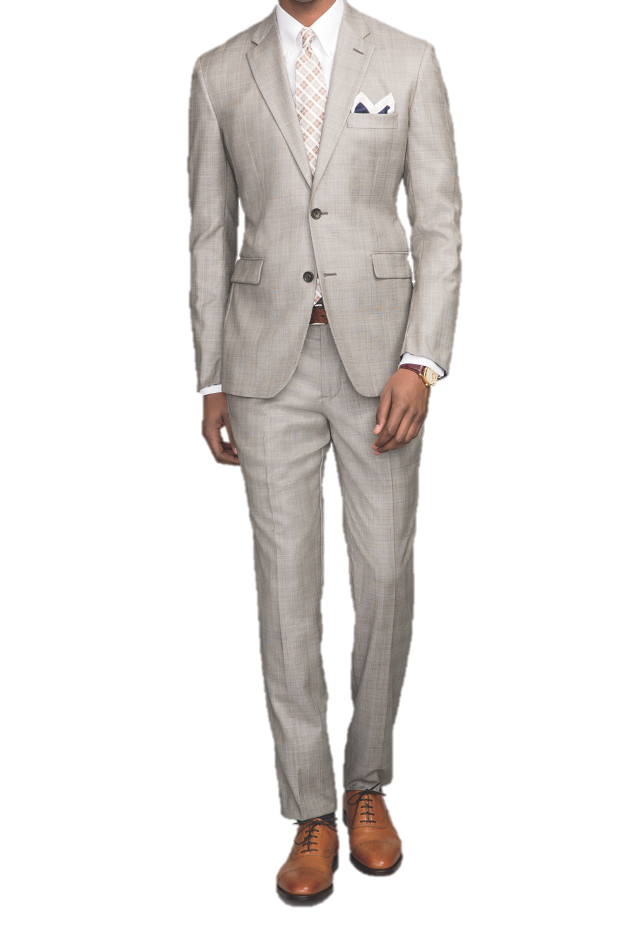
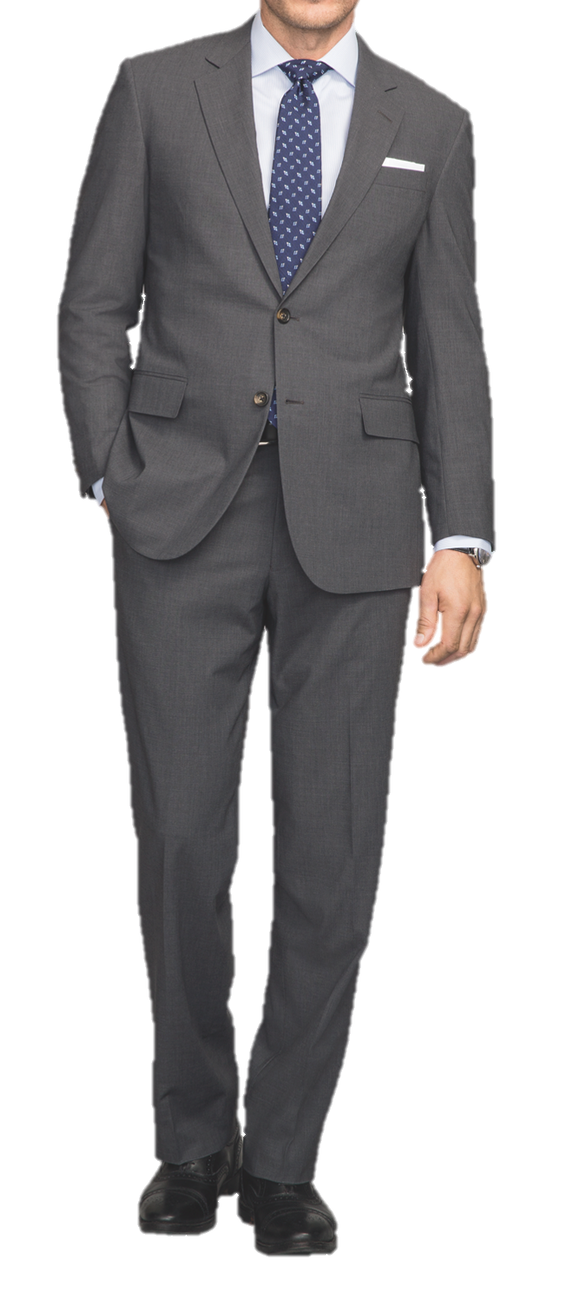
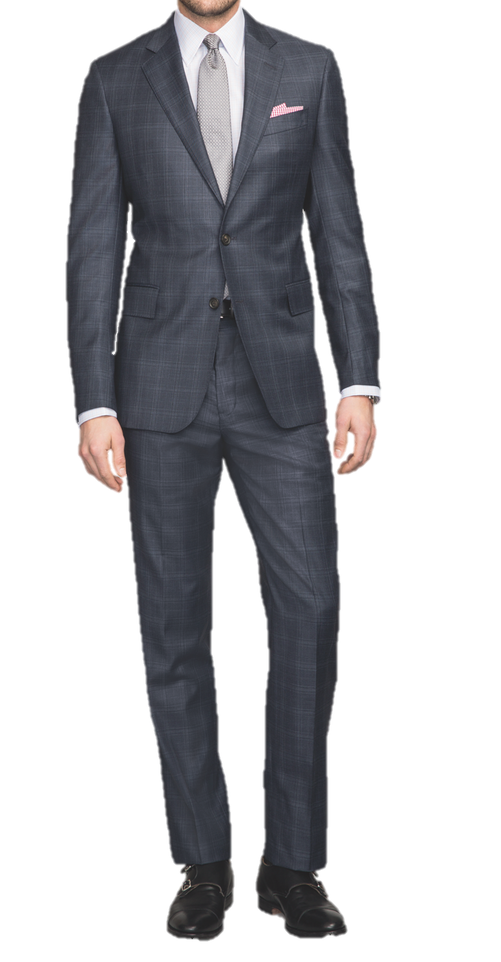
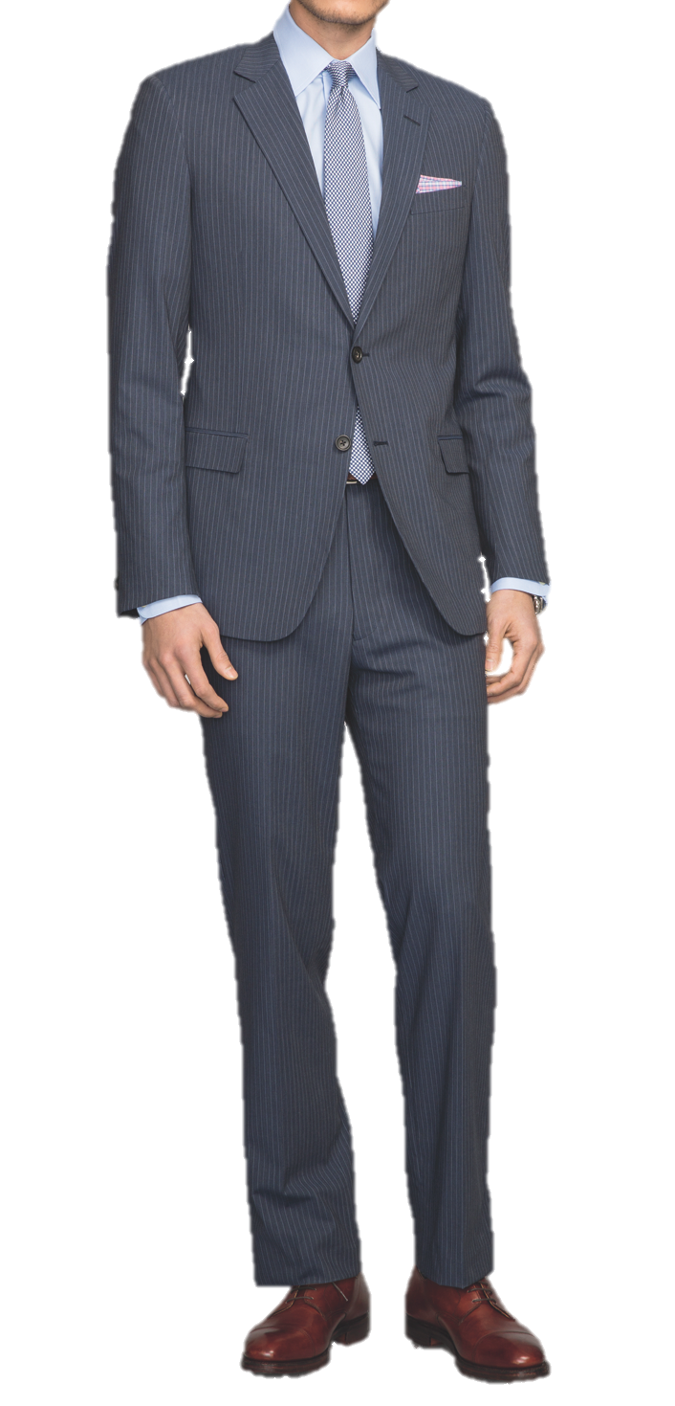
Classic Suiting

Slide 31
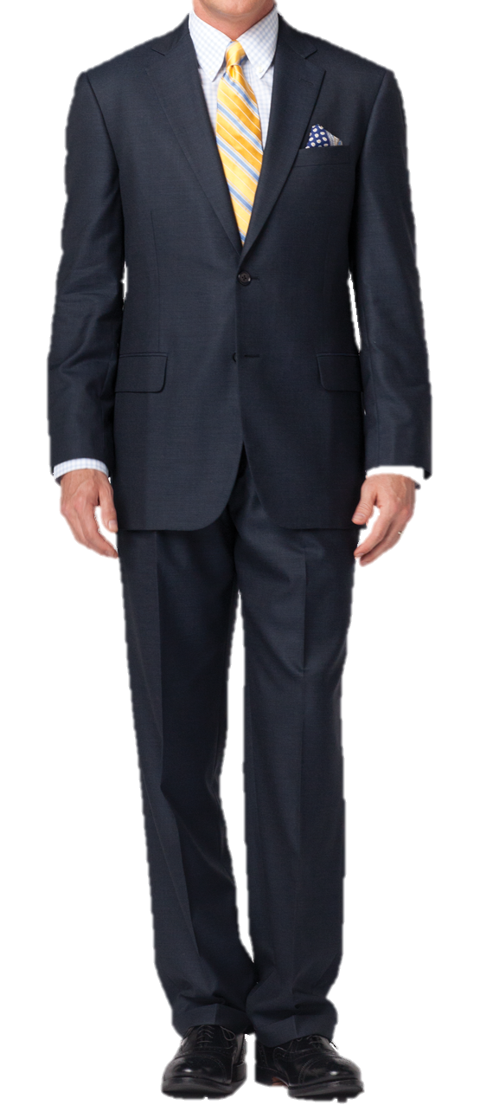
Classic Suiting
BUILDING YOUR WARDROBE
Navy Blue Suit

Slide 32
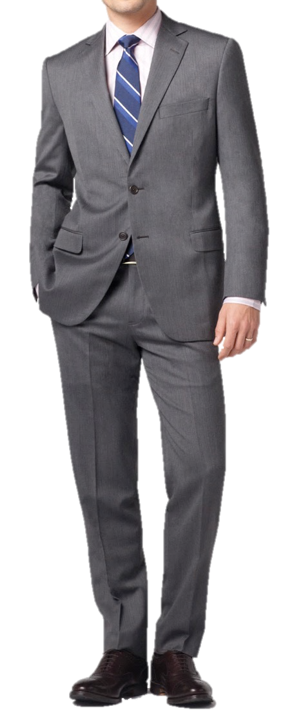
Classic Suiting
BUILDING YOUR WARDROBE
Navy Blue Suit
Grey Suit

Slide 33
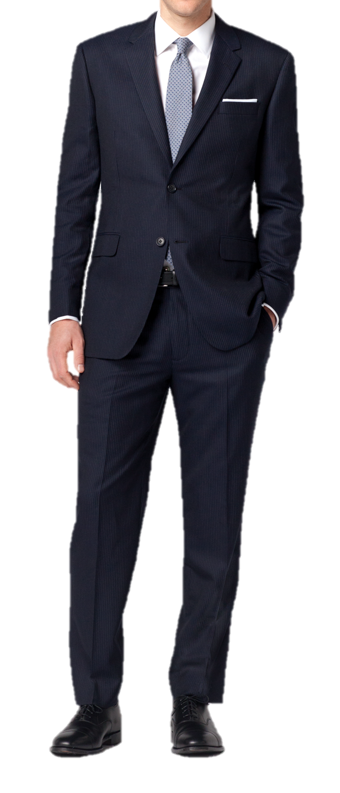
Classic Suiting
BUILDING YOUR WARDROBE
Navy Blue Suit
Grey Suit
Navy Pinstripe Suit

Slide 34
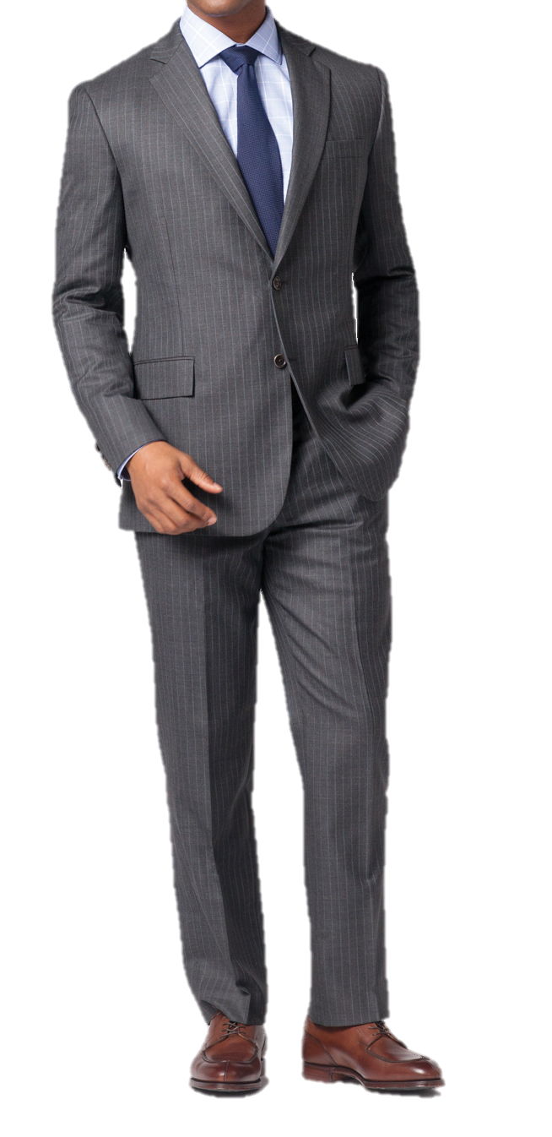
Classic Suiting
BUILDING YOUR WARDROBE
Navy Blue Suit
Grey Suit
Navy Pinstripe Suit
Grey Pinstripe Suit

Slide 35
Classic Suiting
SIZING
Short, Regular, Long & Xlong
FITS
Madison, Regent, Fitzgerald, Milano
RedFleece

Slide 36
The Dress Shirt

Slide 37
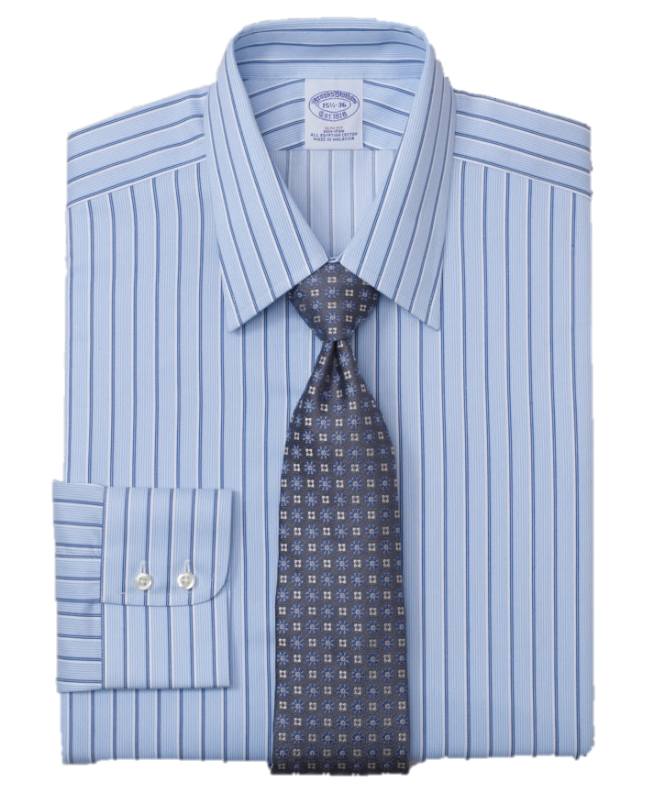
The Dress Shirt
Forward Point Collar

Slide 38
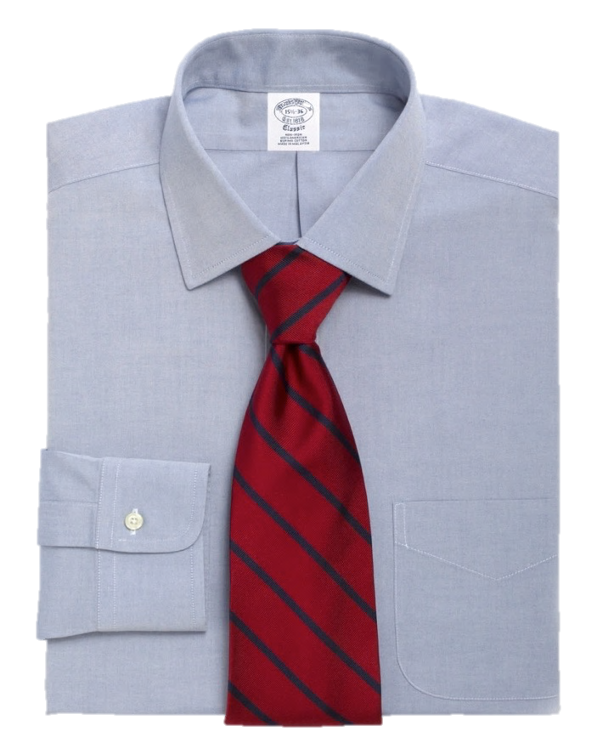
The Dress Shirt
Ainsley Spread Collar

Slide 39
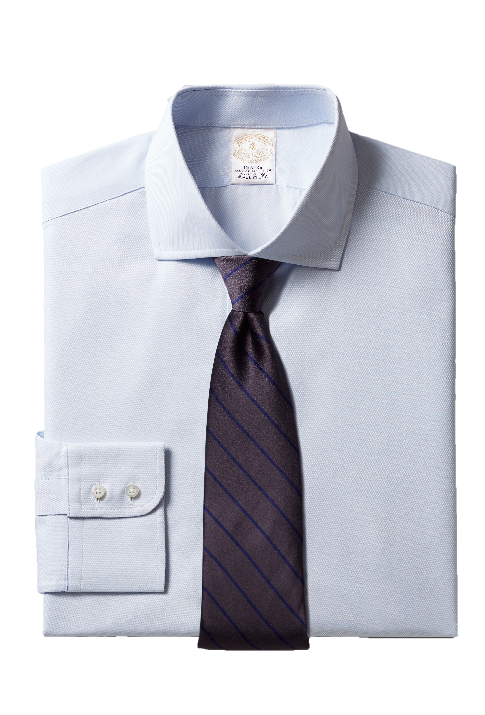
The Dress Shirt
English Spread Collar

Slide 40
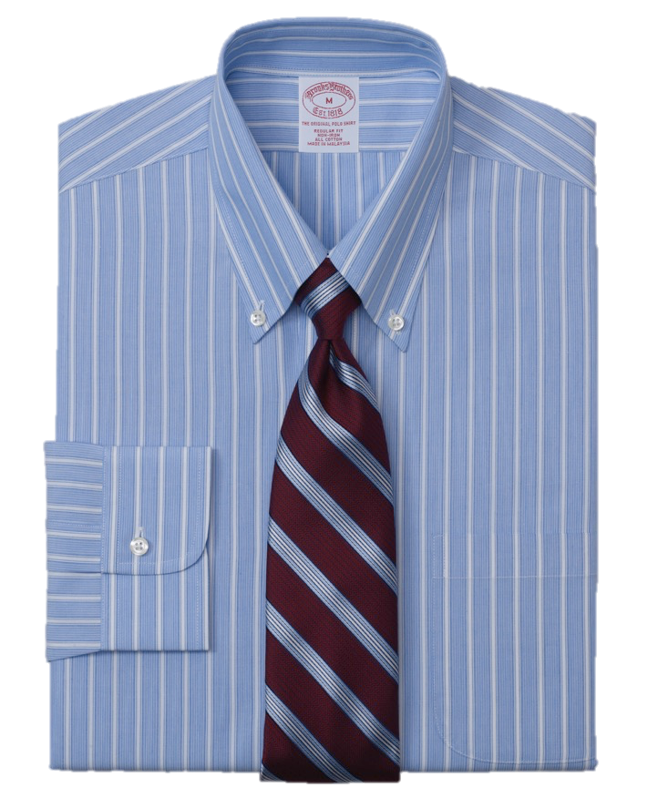
The Dress Shirt
Button Down Collar

Slide 41
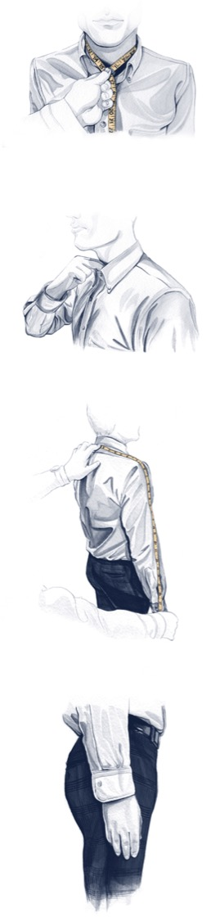
The Dress Shirt
SIZING
Neck & Sleeve Length
FIT
Regular Fit
Slim Fit
Extra Slim Fit

Slide 42
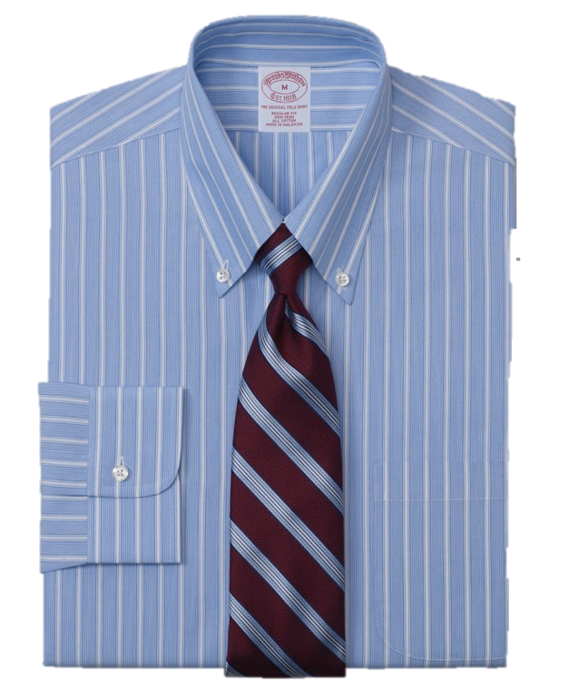
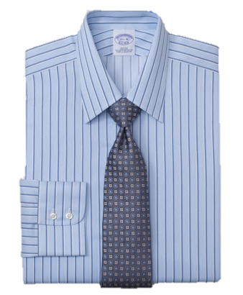
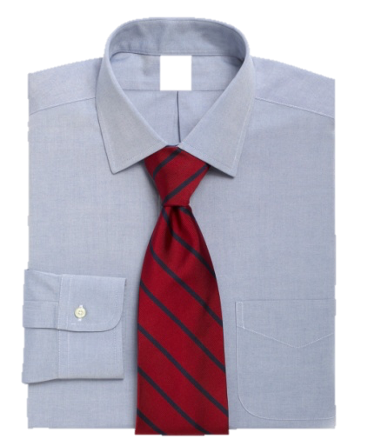
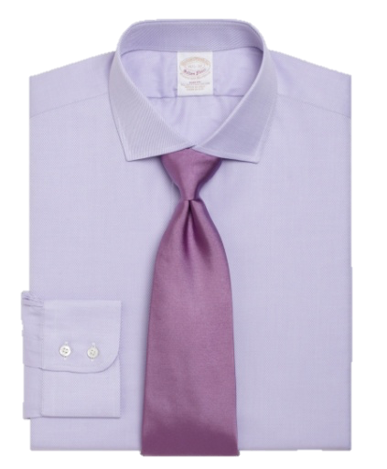
The Dress Shirt
FABRICS
Broadcloth
Oxford
Non-iron finish

Slide 43
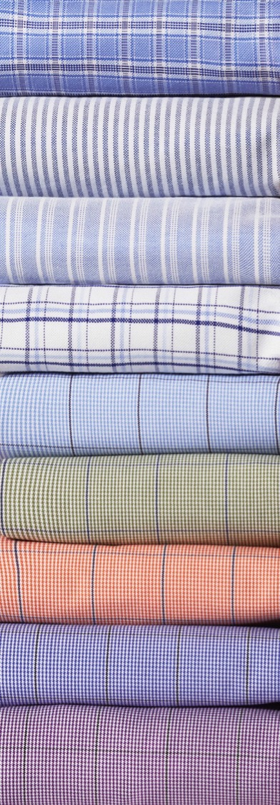
The Dress Shirt
COLORS
Blue and White are always a classic choice
Choose patterns, stripes, plaids and ginghams that are subtle and muted
Dark colors are typically not suitable for business attire

Slide 44
The Tie

Slide 45
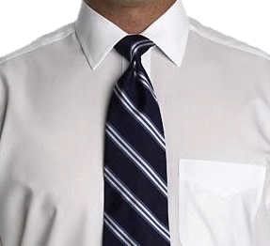


The Tie
FULL WINDSOR KNOT
Wide triangular knot
Ainsley or English spread collar
HALF WINDSOR KNOT
Medium triangular knot
Forward point & button-down shirts
BOW TIE
A tie with a lot of personality Not appropriate for job interviews

Slide 46




The Tie
REPP
Most classic
WOVEN
Best depth of pattern and color
SOLID SILK
Very dressy KNIT OR COTTON
Very casual

Slide 47
The Tie
COLORS
Yellow or a red tie with white shirt is classic
Tie color and pattern non-distracting
Solid colors or subtle patterns such as stripes and dots are preferred for business attire

Slide 48


The Tie
SHIRT & TIE SELECTION
Large checkered tie with a small checkered shirt
Pair a wide striped tie with a thin striped shirt
The focus should be on either the tie or the shirt
Tie tip is same level as the bottom of your belt buckle

Slide 49
Business Casual

Slide 50

The Sport Coat
Great option to wearing a suit
Seasonal colors and fabrics work best

Slide 51

The Navy Blazer
Typically with metallic buttons
A Navy Blazer should never be worn with navy trousers

Slide 52

The Pants
GABARDINES
Seasonal fabrics: linen, cotton, wool
Flat front vs. pleated

Slide 53

The Pants
CHINOS
Flat front or pleated

Slide 54

The Pants
JEANS
Must Fit Properly
No Holes or Bleaching

Slide 55



The Pants
THREE COMMON BREAK OPTIONS
NONE
SLIGHT
FULL

Slide 56

The Sports Shirt
Looser fitting than a dress shirt
Typically has a button-down collar Sized S, M, L, XL

Slide 57

The Sweater
V-neck vs. Crew Neck
Great For Layering
Wools and Cashmeres
Cooler Climates
Cotton, Silk and Linen
Warmer Climates

Slide 58
Footwear & Accessories

Slide 59


Footwear
Classic Colors
Black, Brown & Cordovan
Classic Styles
Cap Toe & Wing Tip
Casual Styles
Loafer & Driving Shoe

Slide 60




Belts
Classic Colors
Black, Brown and Cordovan Leather
Classic Buckles
Gold and Silver
Casual Styles
Woven and Fabric Belts
Belt Should Match Your Shoes

Slide 61





Socks & Undershirts
SOCKS
Blend with the trousers
No white socks EVER
UNDERSHIRTS
V-Neck with an open shirt

Slide 62







Accessories
POCKET SQUARES
Great accent
COLLAR STAYS
CUFFLINKS
Classic and Simple
WATCHES
Classic and Simple

Slide 63




Accessories
OVERCOAT
Fabric
Sizing
Length
BRIEFCASES
NO Backpacks

Slide 64


Wear & Care
ALWAYS PRESS YOUR CLOTHING
DRY CLEANER
Pants with jacket
No more than three to four times a year
WOODEN HANGERS SHOULD BE USED FOR JACKETS
SHINE AND BUFF YOUR SHOES
SHOE TREES HELP IN MAINTAINING SHAPE

Slide 65
Wrap-Up

